Slide 1


Slide 2


Slide 3


Slide 4


Slide 5


Slide 6


Slide 7


Slide 8


Slide 9


Slide 10


Slide 11


Slide 12


Slide 13


Slide 14


Slide 15


Slide 16
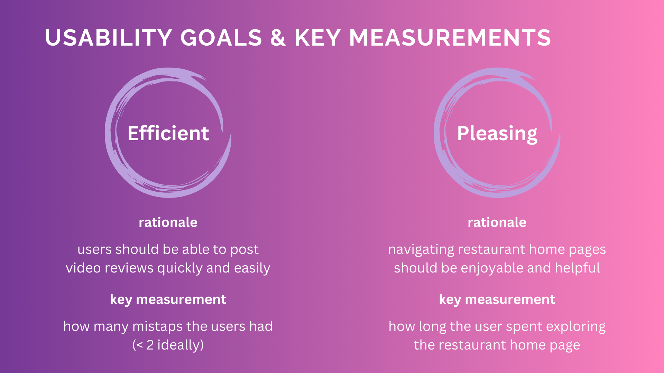

Slide 17
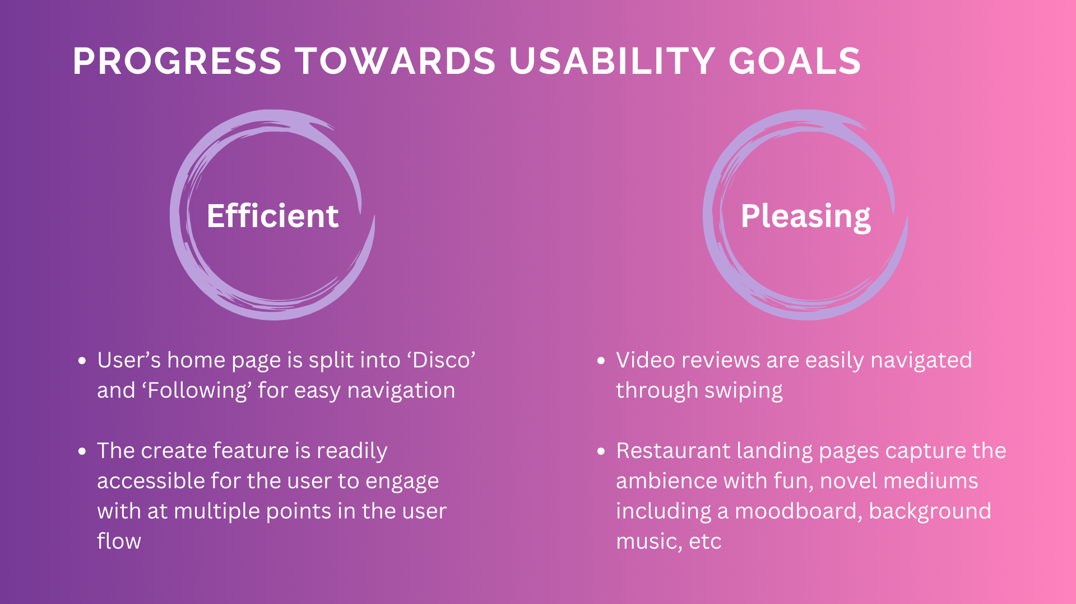

Slide 18


Slide 19
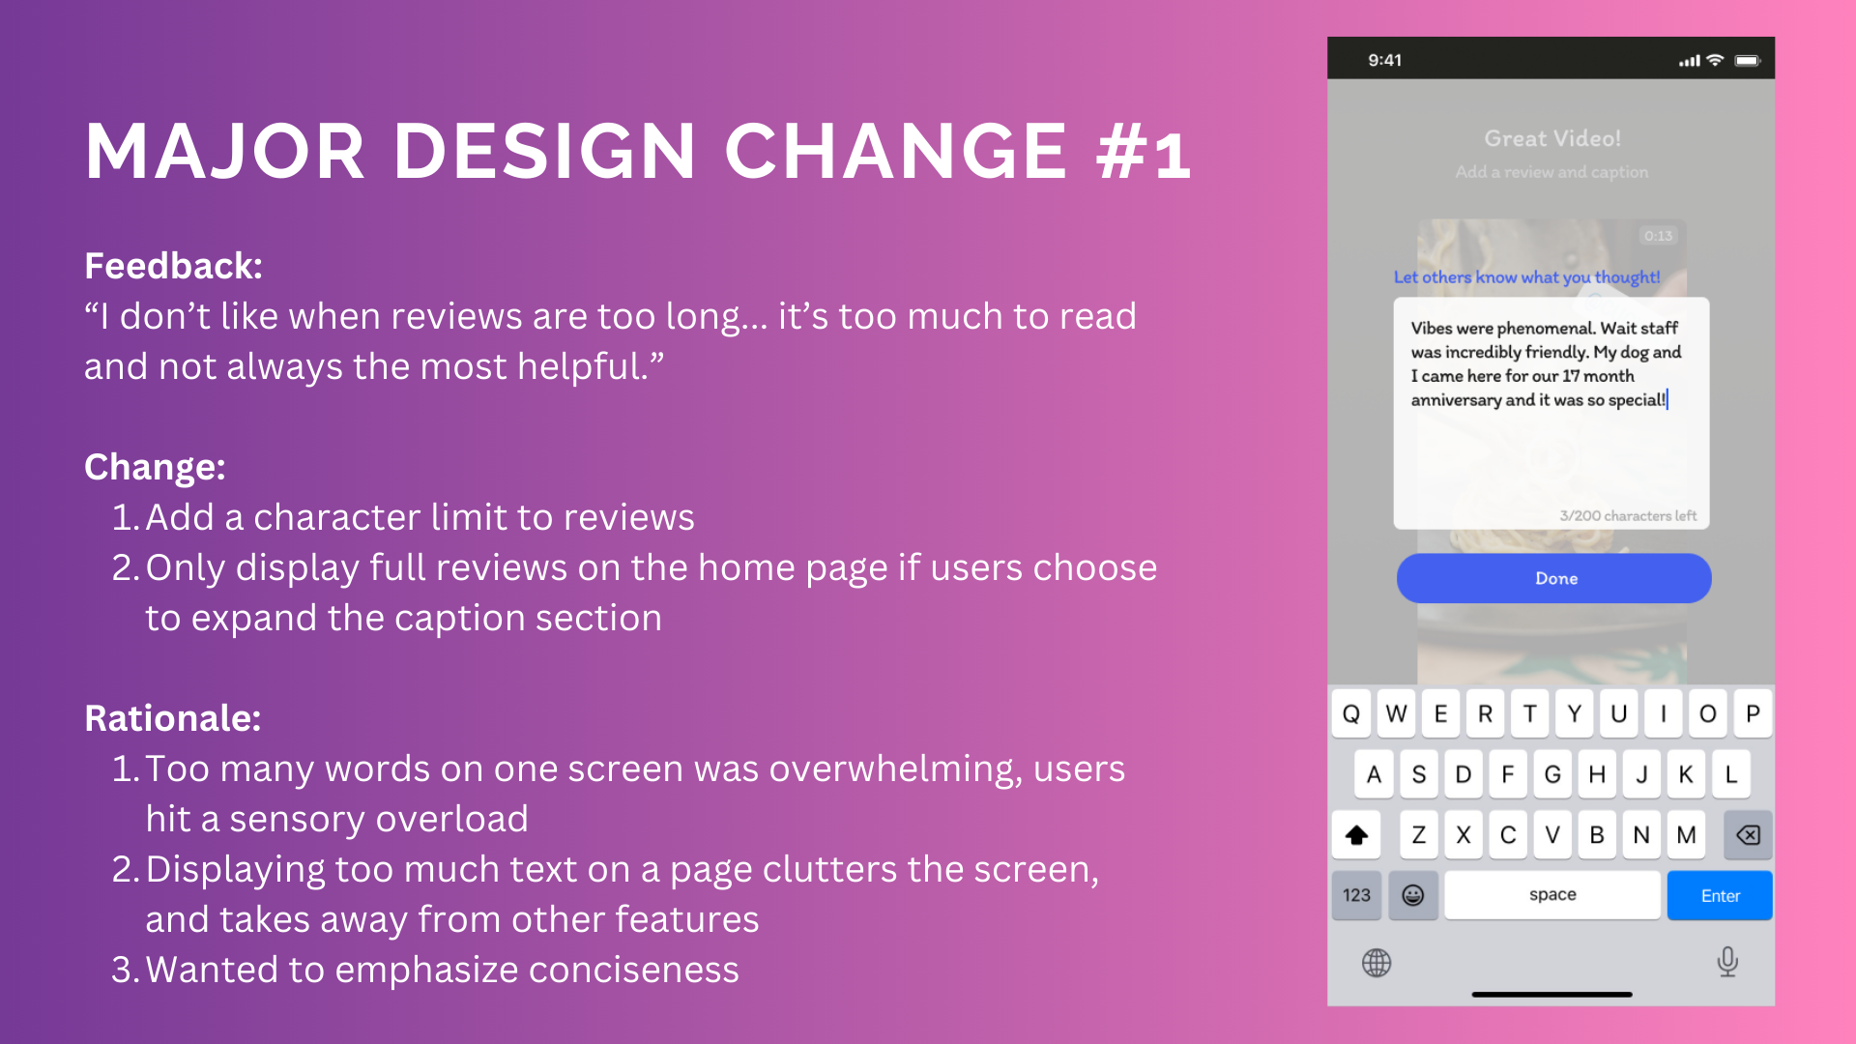
Notes:
See appendix for before & after sketches

Slide 20
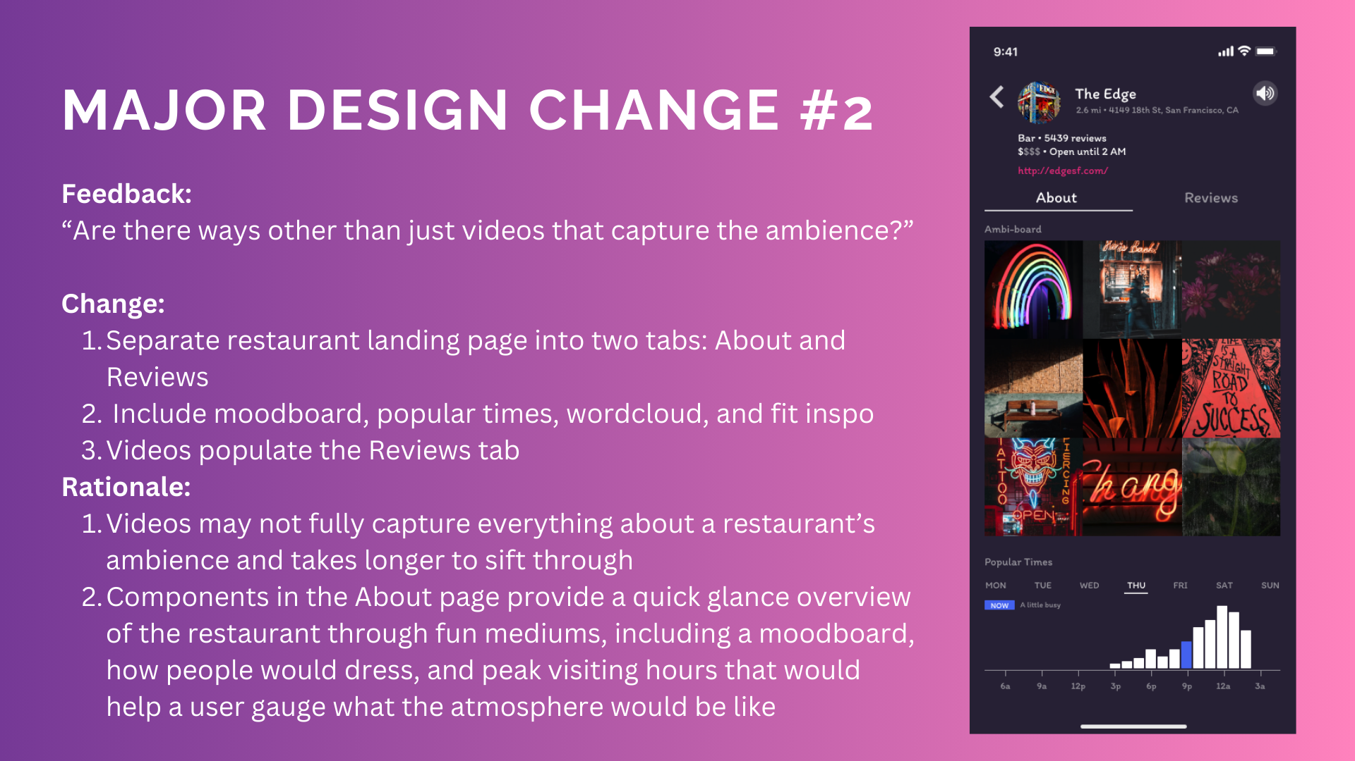
Notes:
See appendix for before & after sketches

Slide 21
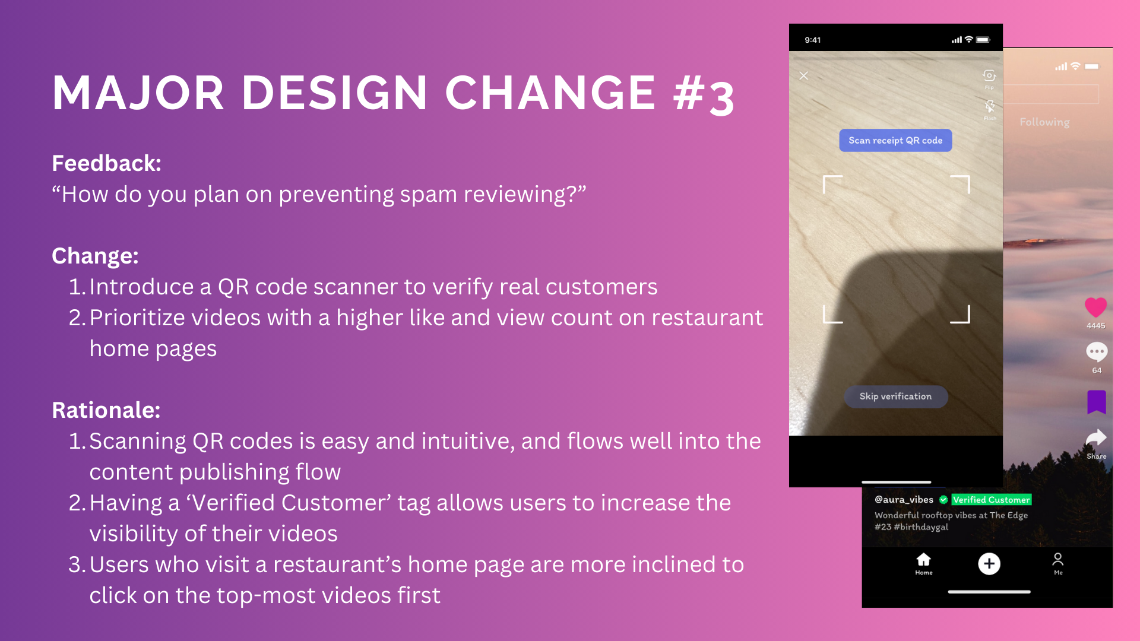
Notes:
See appendix for before & after sketches

Slide 22


Slide 23
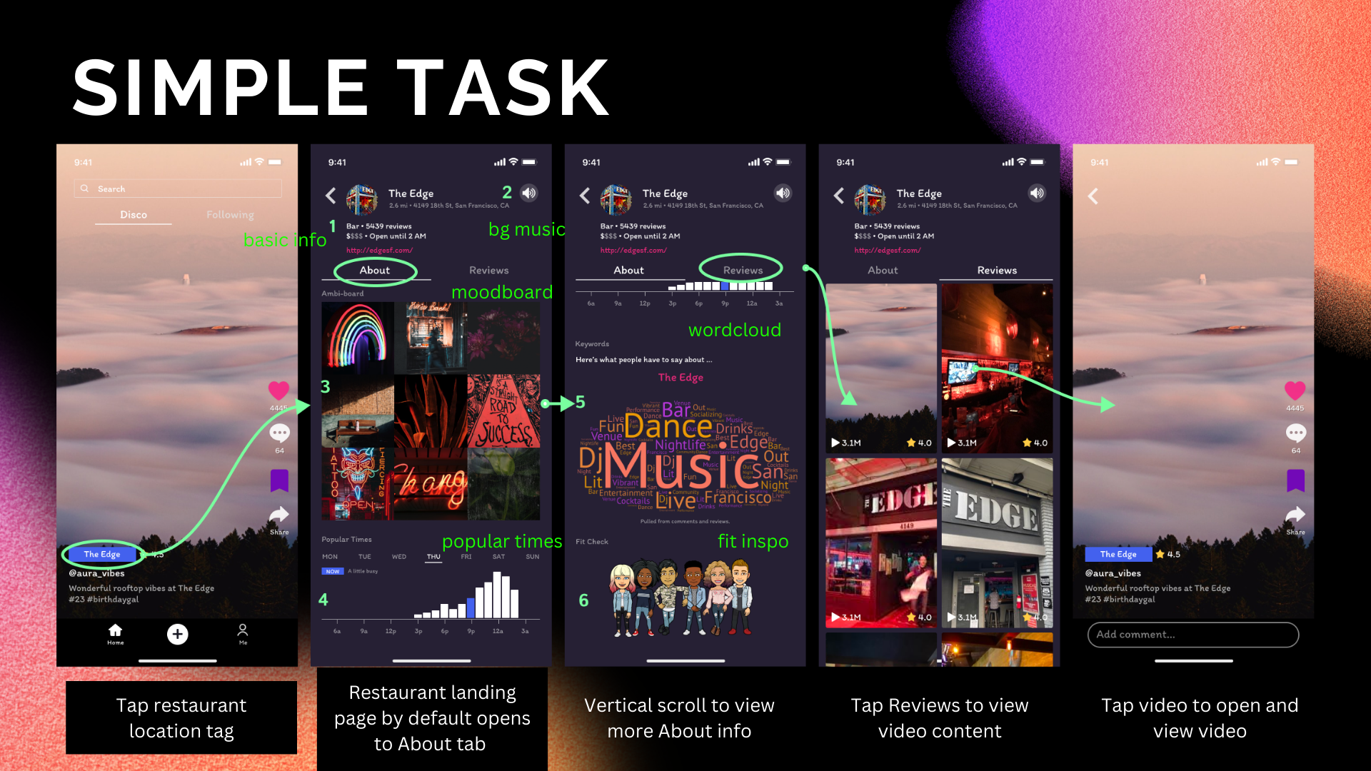

Slide 24
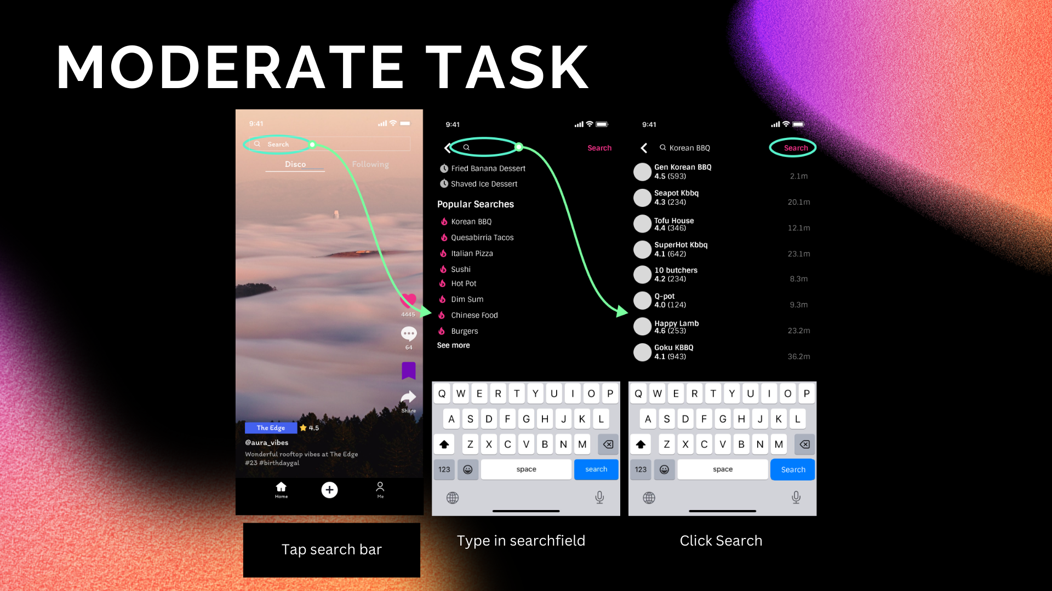

Slide 25
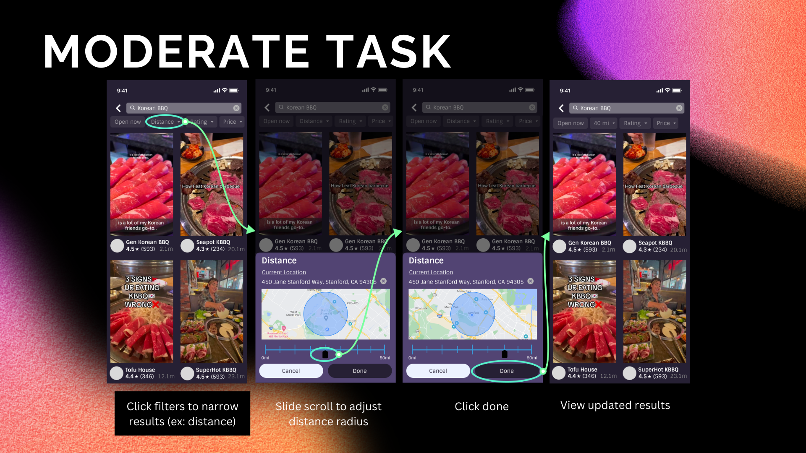

Slide 26
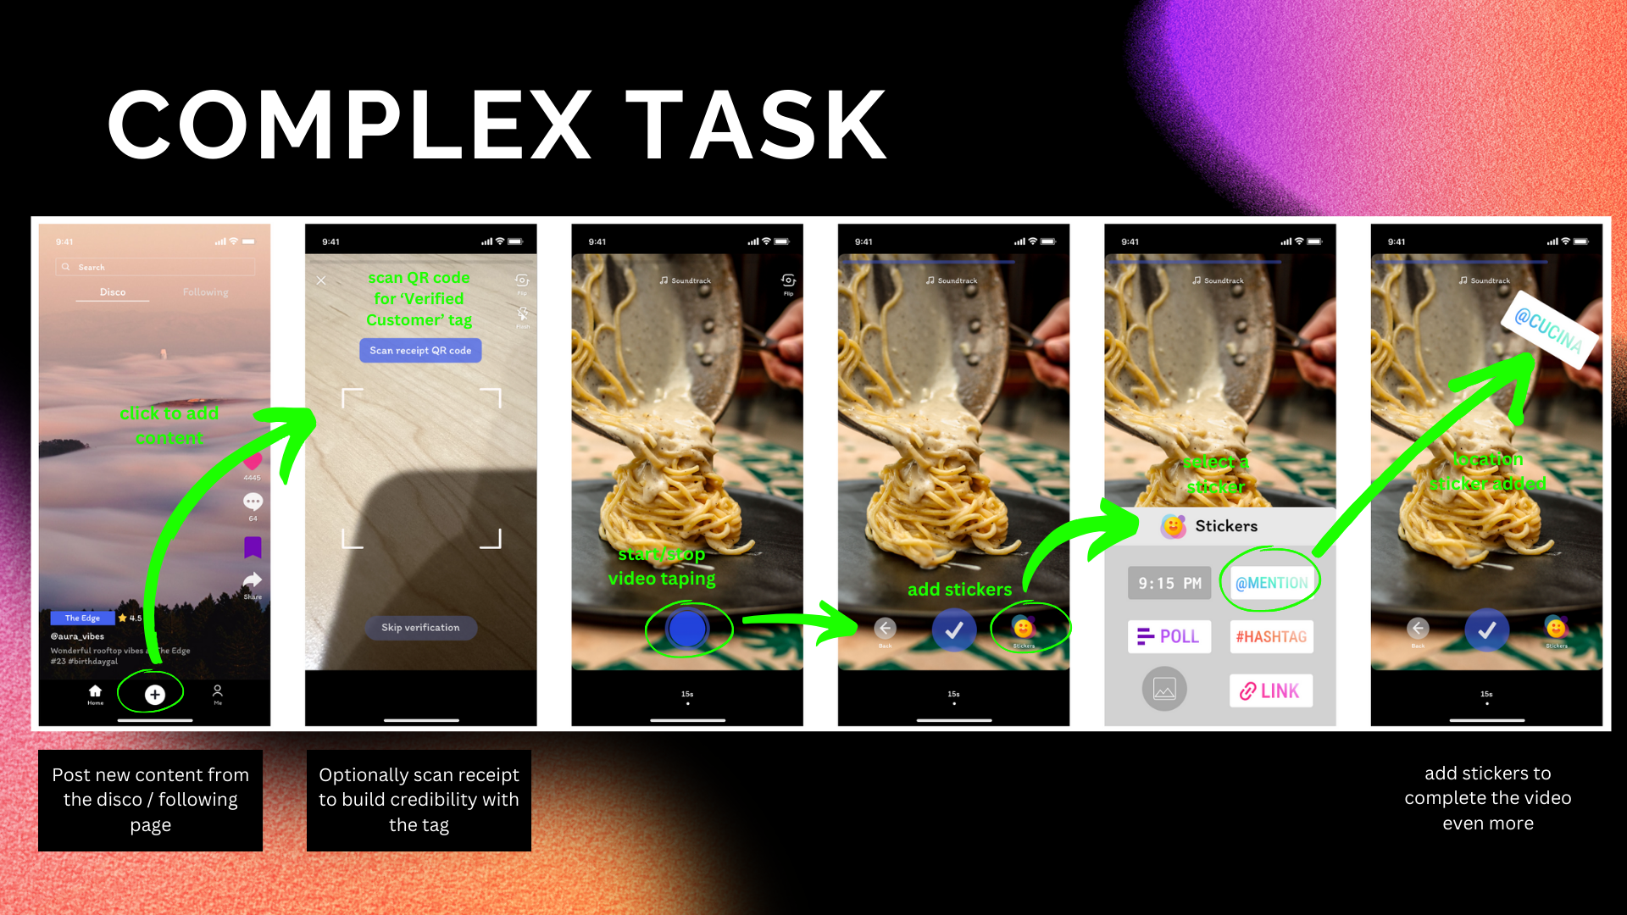

Slide 27
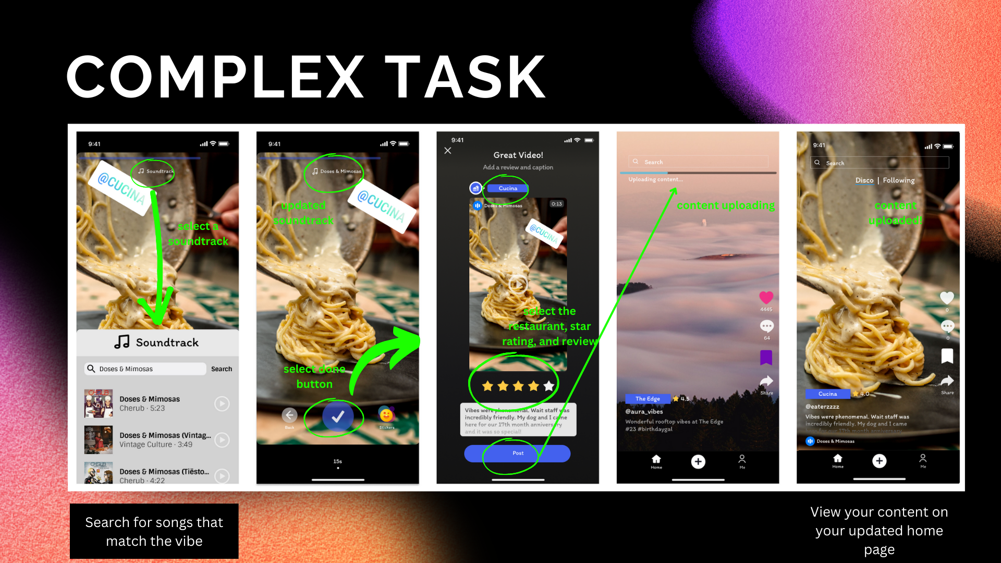

Slide 28


Slide 29
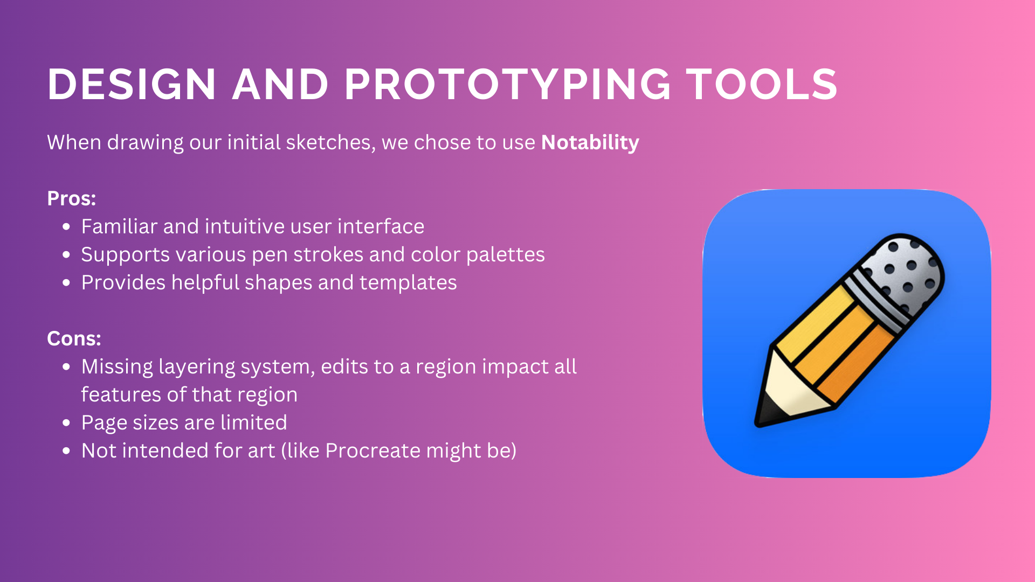

Slide 30
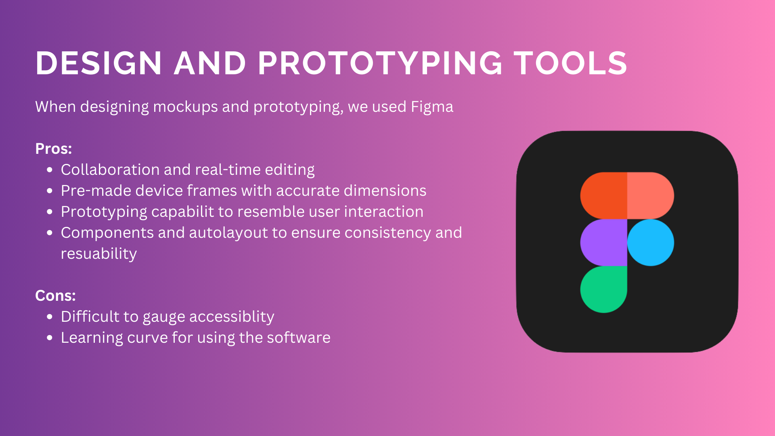

Slide 31
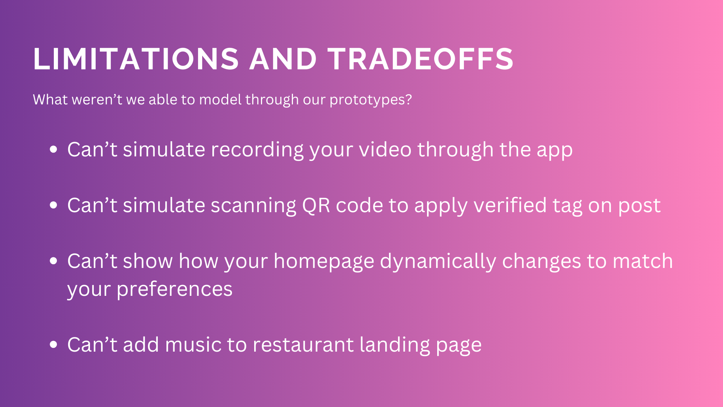

Slide 32
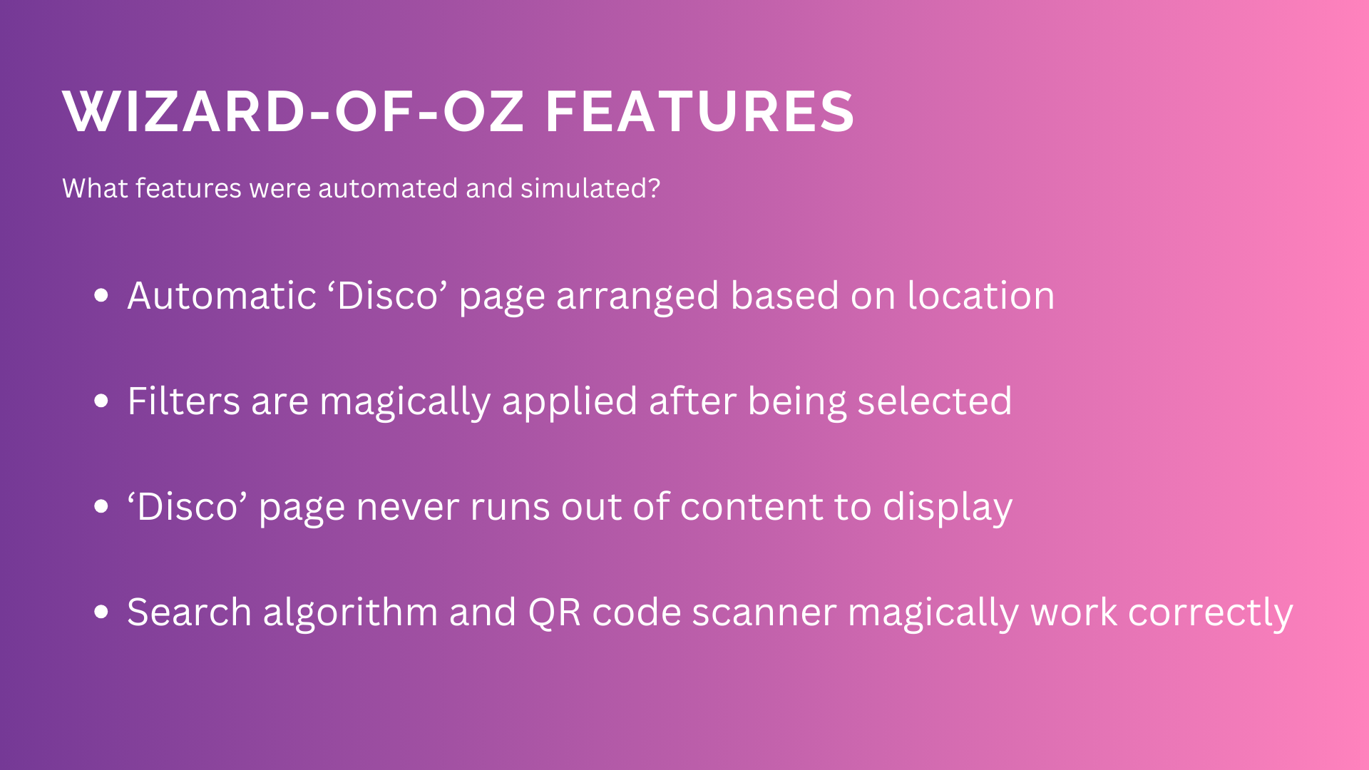

Slide 33
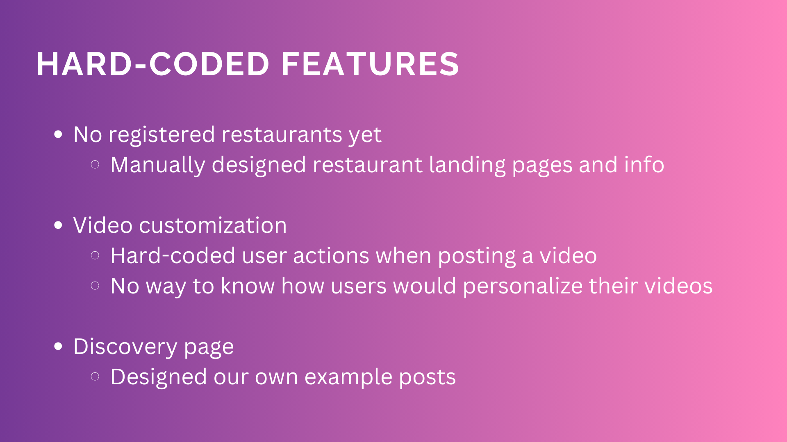

Slide 34


Slide 35

Prototype link
Design file link

Slide 36
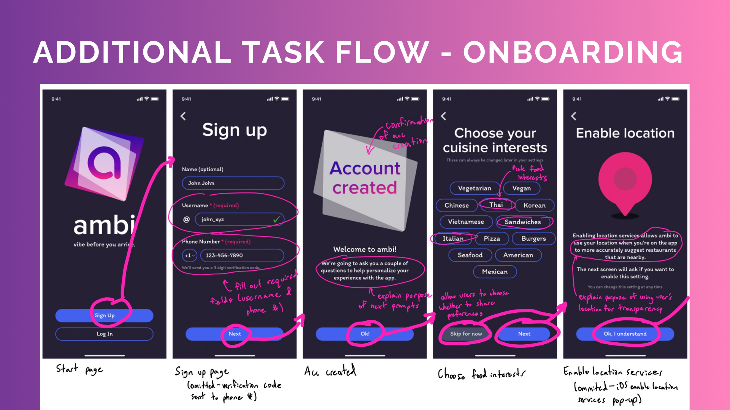

Slide 37
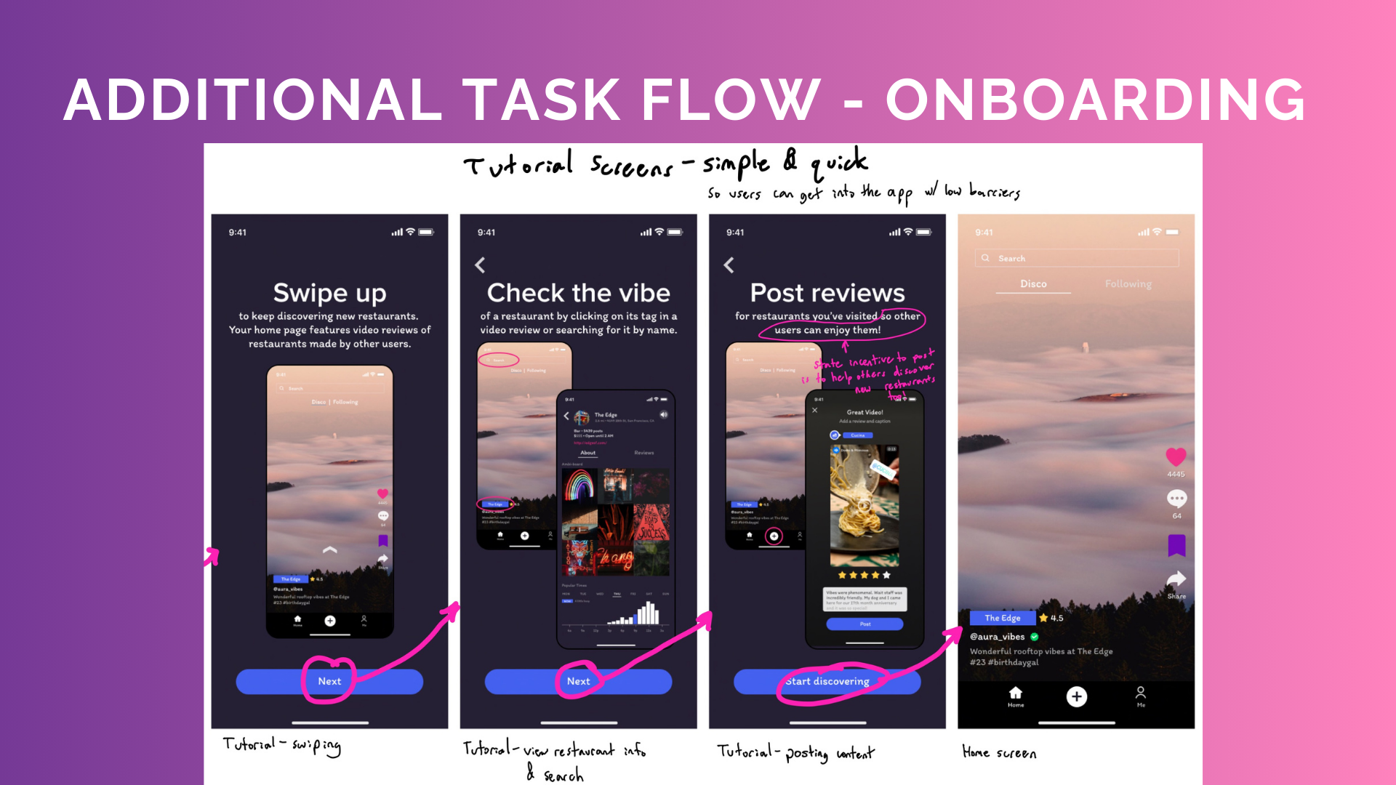

Slide 38
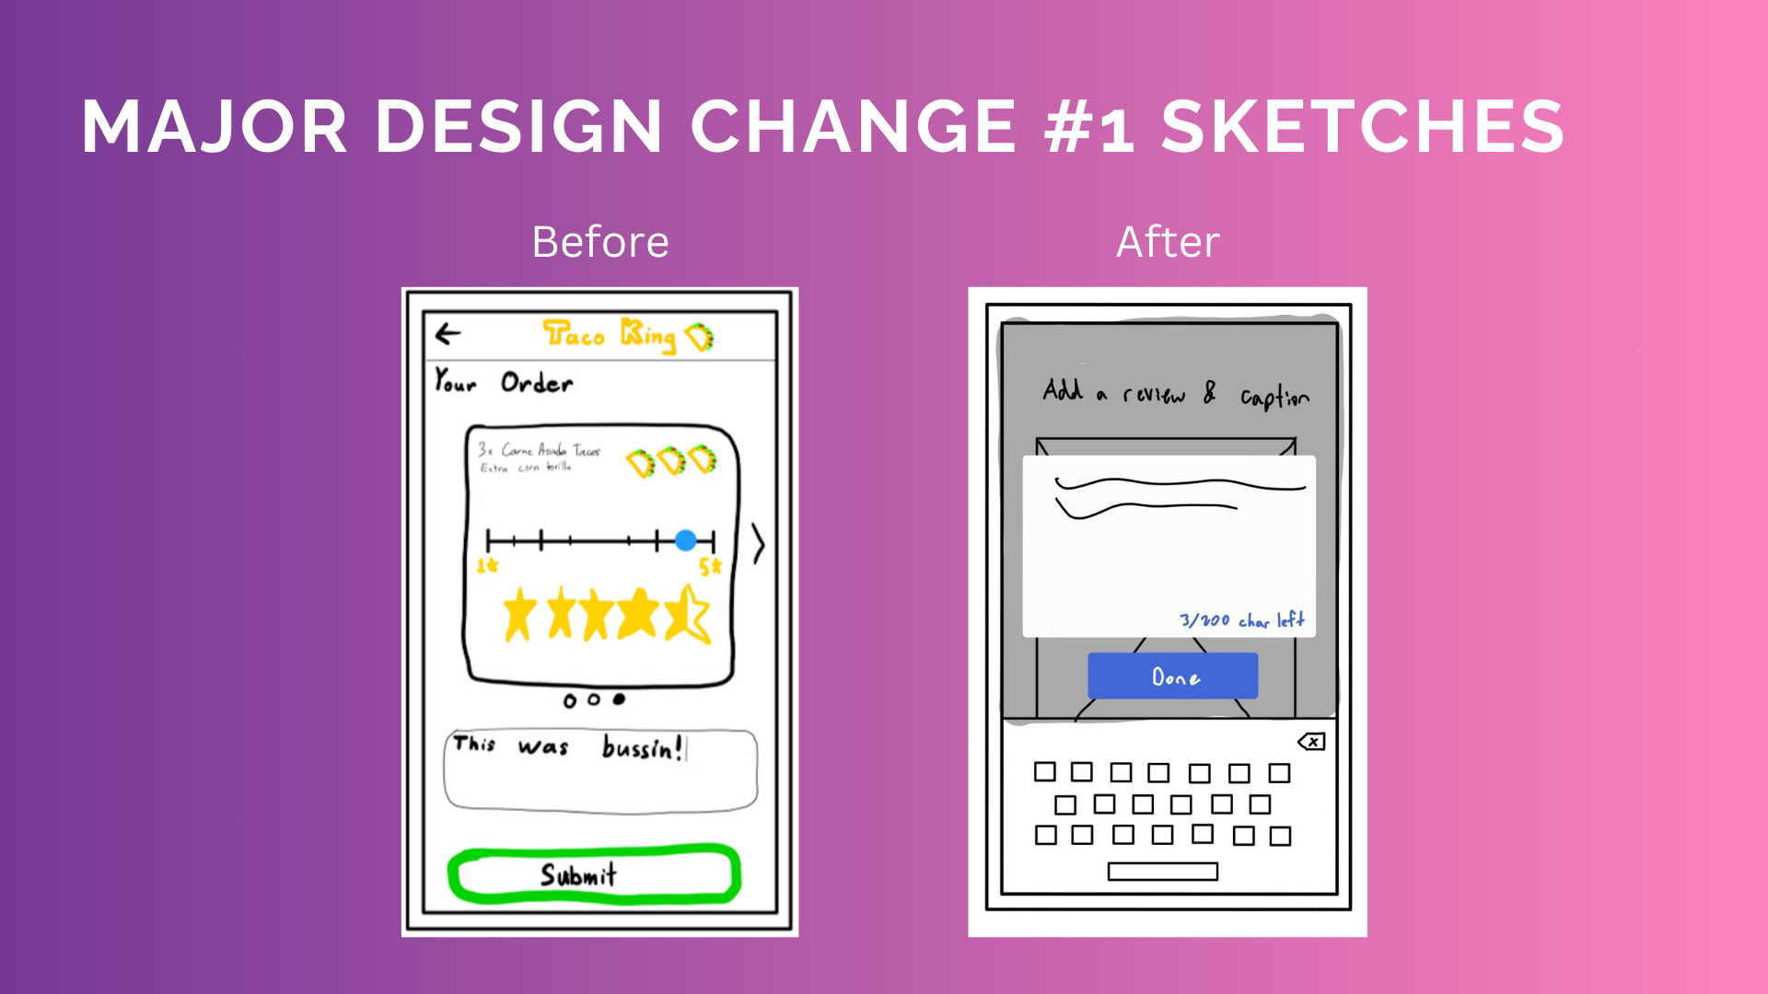

Slide 39
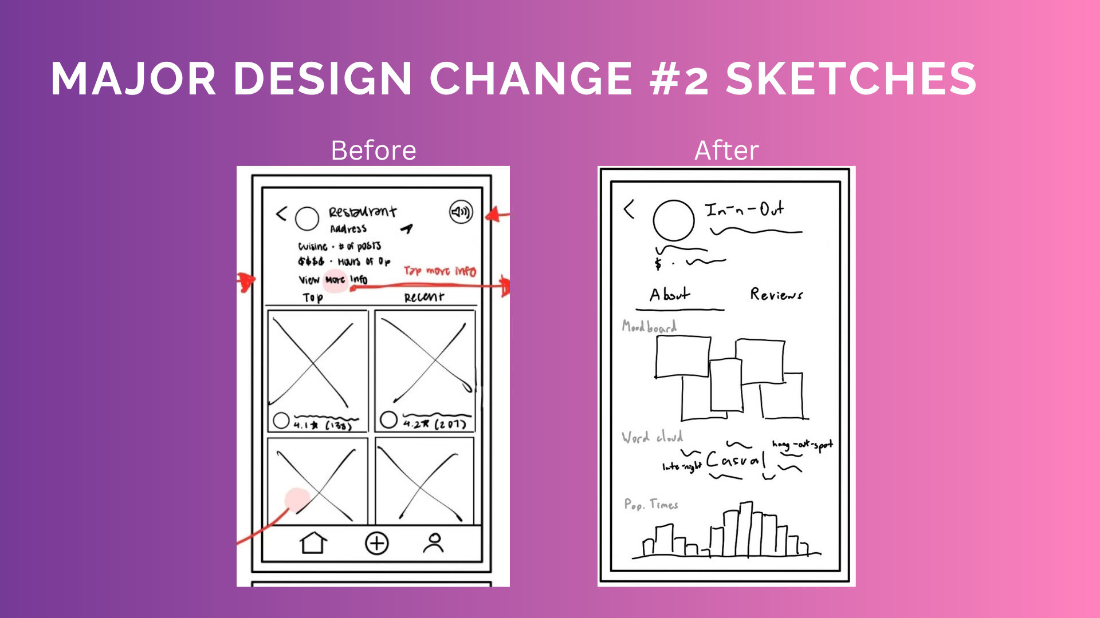

Slide 40
